Slide 1
Bank Churn Predictions
Shivendu Kishore , Ankit Tiwari, Ayush Singh,
January 23, 2024

Slide 2
Churning in Bank Sector - Overview

Slide 3
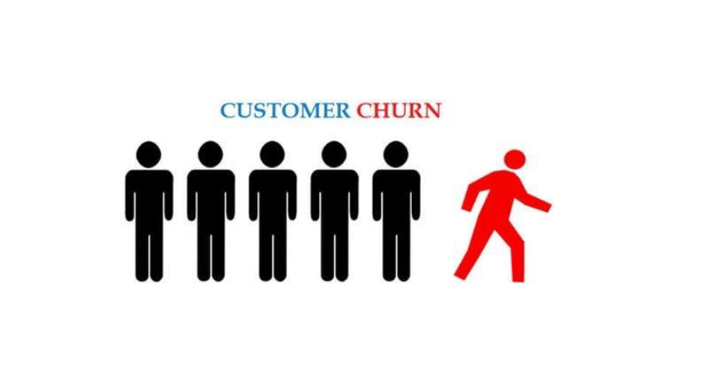

Slide 4
Customer Churn in Banking
Churn is defined as exiting of customer from the service and moving from one company to another.
The reasons can for example be:
Availability of latest technology
Customer-friendly bank staff
Low interest rates
Location
Churn rate usually lies in the range from 10% up to 30%.

Slide 5
Why is this important for the bank?
The cost of attracting new customers can be five to six times more than holding on to an existing customers
Long term customers become less costly to serve, they generate higher profits, and they may also provide new referrals
Losing a customer usually leads to loss in profit for the bank.
`

Slide 6
How to define a churner in a bank
Customer who closes his account or has decreasing number of transactions over a specific period in time
Focus on customers who have three or less products with the bank
Active customer is a customer with two or more active products
A churner can be defined as a customer who has not been active over a specific time

Slide 7
Churning Prediction Model - Concept

Slide 8
Customer Churn Model
Prediction models are used to identify customers who are likely to churn
The model uses historical data on former churners and tries to find some similarity with existing customers
If some similarity is found those customers are classified as potential churners.

Slide 9
What needs to be considered when setting up a churn model?
How to define a churner in the bank
Churn prediction variables to use in the model
Methods/techniques used to build the model

Slide 10
Data Source
Kaggle Churn Modelling Dataset
165034 records
Demographic information
Banking information

Slide 11
Churn prediction variables
Customer demographics variables
Age
Surname
Gender
Geographical data

Slide 12
Churn prediction variables
Bank-Related Variables
Balance
Credit Score
Tenure with bank
Number Of Products of bank used by customer
Has Credit Card
Is Active Member
Estimated Salary

Slide 13
Churn Prediction Modelling
Predict if a bank’s customer will stay or leave the bank by taking insights from historical dataset
Exited – 0 – Not leave
Exited – 1 – Leave

Slide 14
Process Theory - Working

Slide 15
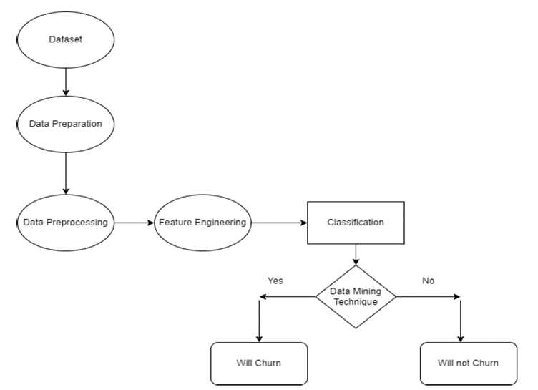

Slide 16
Steps for Prediction Model
Loading Data
Data Exploration
Data Visualization
Feature Preprocessing & Engineering
Model Selection
Validation
Submission

Slide 17
ETL

Slide 18
ETL
Kaggle Dataset → Cleaning
Removing features not needed for ML:
RowNumber
CustomerId
Save it as the analytical base table (train_mod, test_mod)
(train_mod, test_mod) → input to all modelling notebooks
Extract, Transform, Load

Slide 19
Data Visualization- Insights from Data

Slide 20
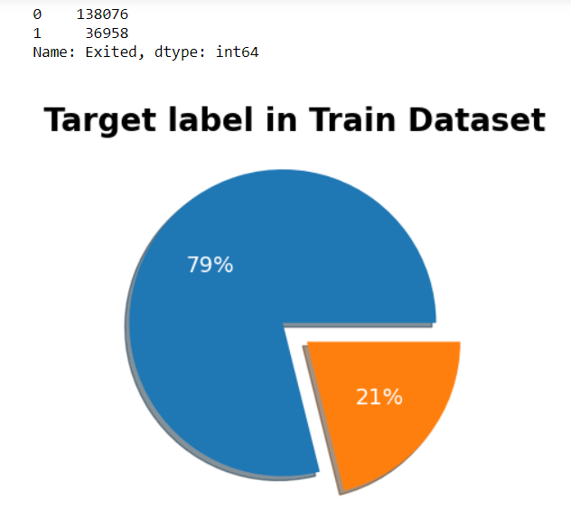
Target Feature Distribution
Imbalanced dataset:
Stays - 79%
Exits - 21%
Handling imbalanced classes:
StratifiedKFold

Slide 21
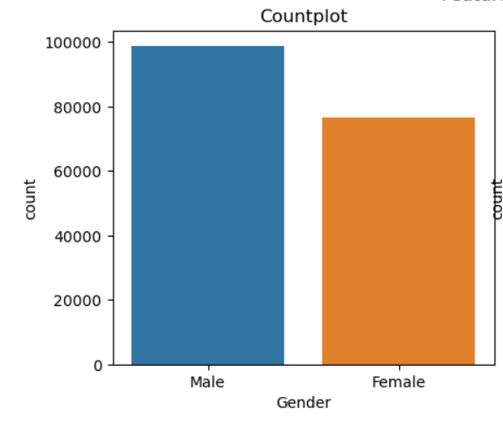
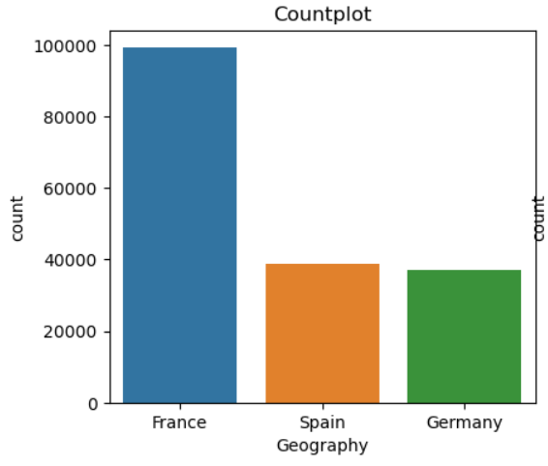
Distributions of Categorical Features
More males than females
France 50%; Spain, Germany 25% each

Slide 22
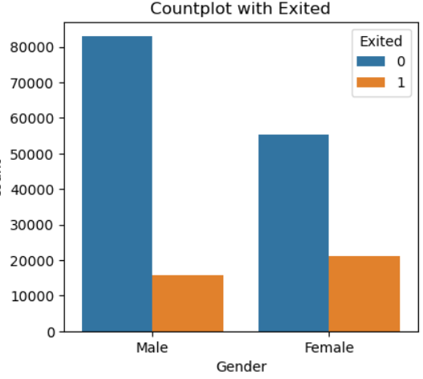
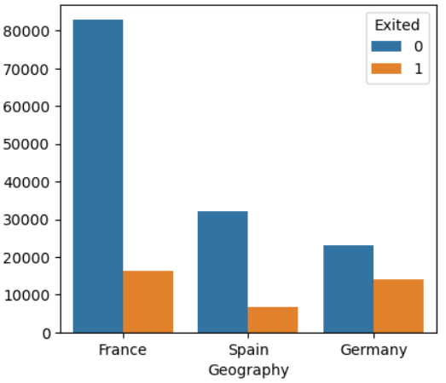
Churn Segmentation by Gender/Geography
Leaving bank:
Females 28%
Males 16%
German customers 38%
Germany: least num of customers → most churn

Slide 23
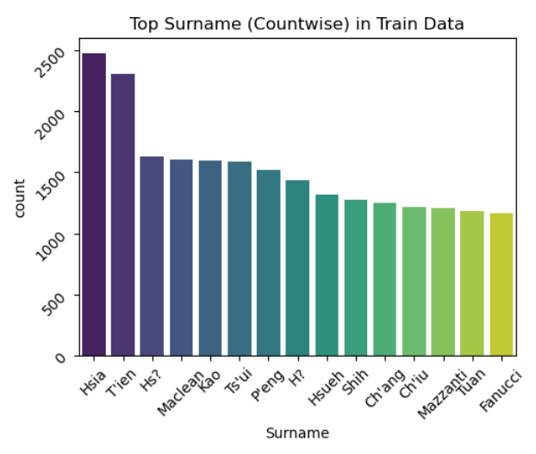
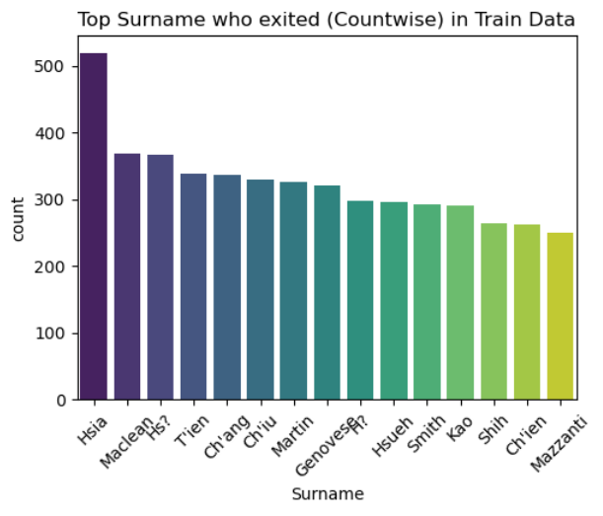
Distributions of Categorical Features
Top Surnames in the dataset
Top Surnames Exited in the dataset

Slide 24
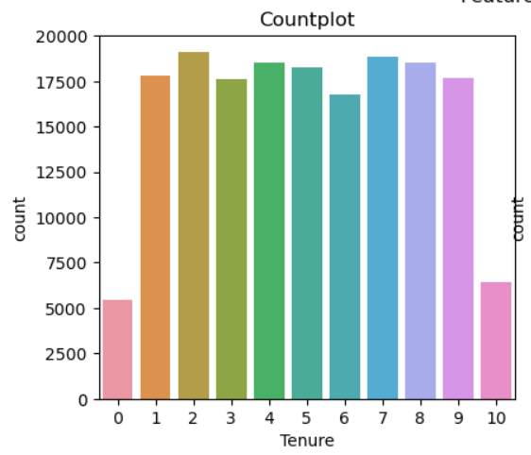
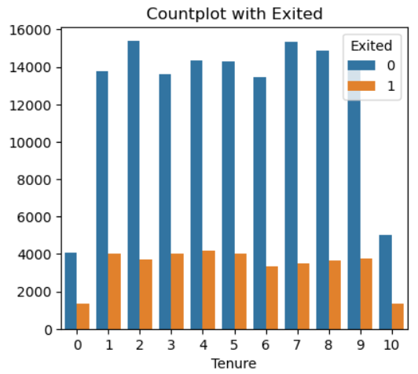
Distributions of Categorical Features
Customers with bank in years(Tenure) in the dataset
Customers with bank in years (Tenure) Exited in the dataset

Slide 25
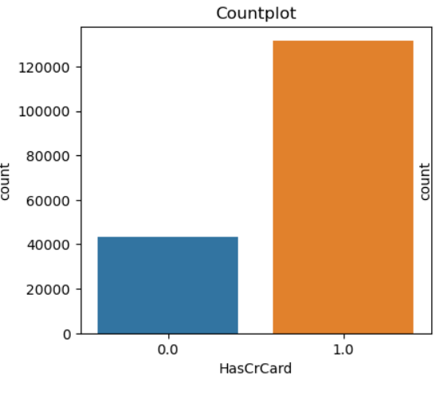
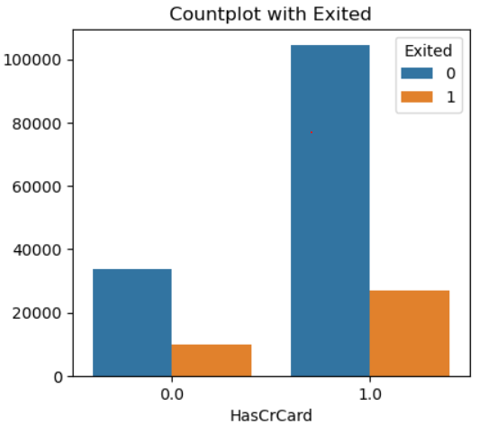
Distributions of Categorical Features
Customers having credit card
Customers having credit card exited

Slide 26
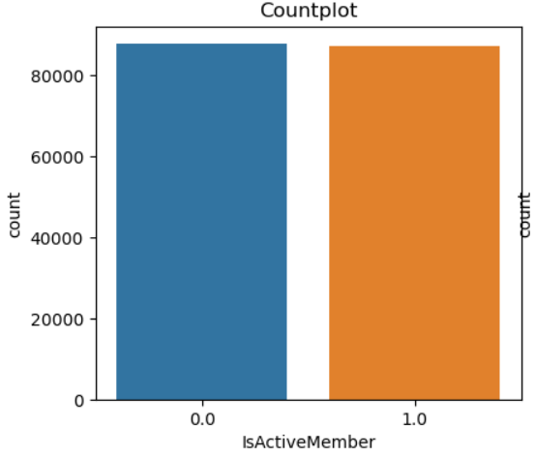
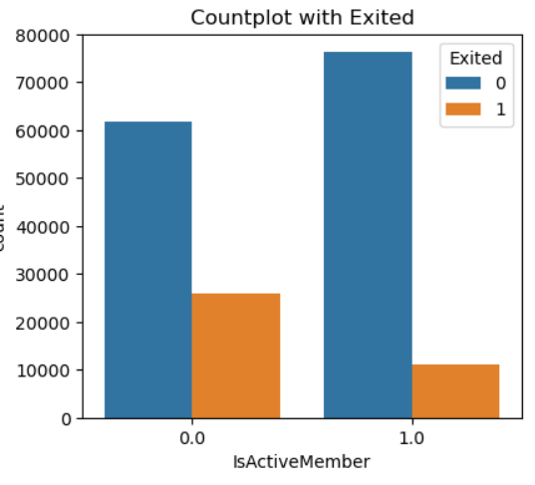
Distributions of Categorical Features
Active Member of bank
Active Member of bank Exited

Slide 27
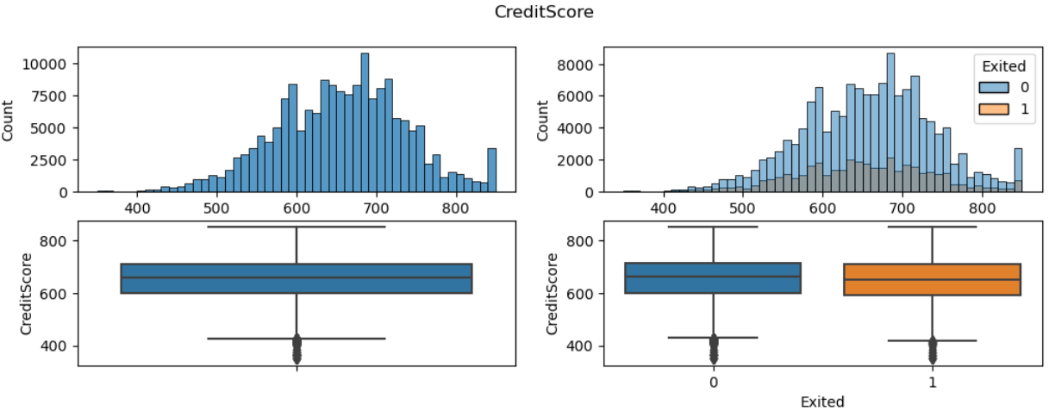
Numerical Features - Histplot and Boxplot
Outliers on lower side of IQR
Notes:
Very weak correlations in general. Only weak positive correlation with age, very weak positive correlation with balance, and very weak negative correlations with number of products and membership.
The density plots on the diagonal make it easier to compare these distributions. We can notice that only few features have slightly different distributions. For example, from the density plot for Age, it could be seen that older people have slightly higher tendency to leave the bank.

Slide 28
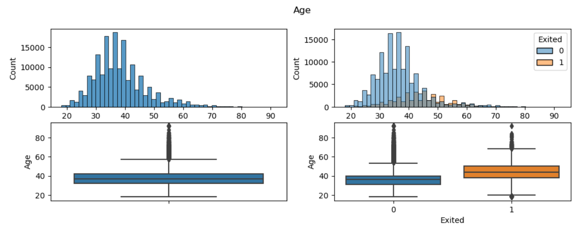
Numerical Features - Histplot and Boxplot
Outliers on upper side of IQR
Notes:
Very weak correlations in general. Only weak positive correlation with age, very weak positive correlation with balance, and very weak negative correlations with number of products and membership.
The density plots on the diagonal make it easier to compare these distributions. We can notice that only few features have slightly different distributions. For example, from the density plot for Age, it could be seen that older people have slightly higher tendency to leave the bank.

Slide 29
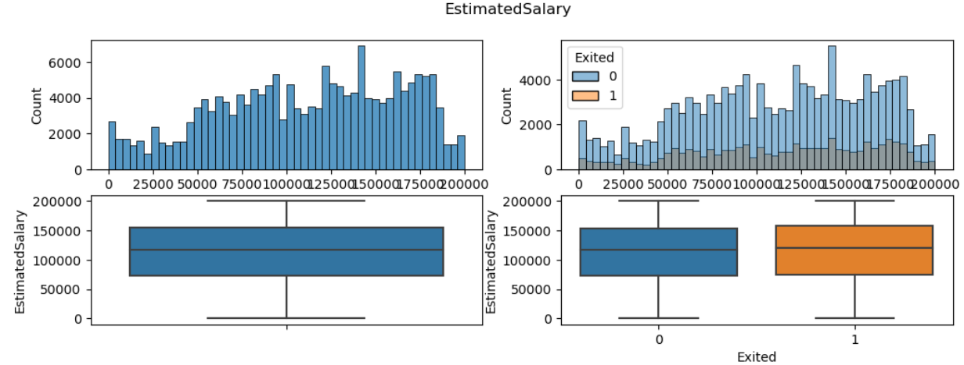
Numerical Features - Histplot and Boxplot
Notes:
Very weak correlations in general. Only weak positive correlation with age, very weak positive correlation with balance, and very weak negative correlations with number of products and membership.
The density plots on the diagonal make it easier to compare these distributions. We can notice that only few features have slightly different distributions. For example, from the density plot for Age, it could be seen that older people have slightly higher tendency to leave the bank.

Slide 30
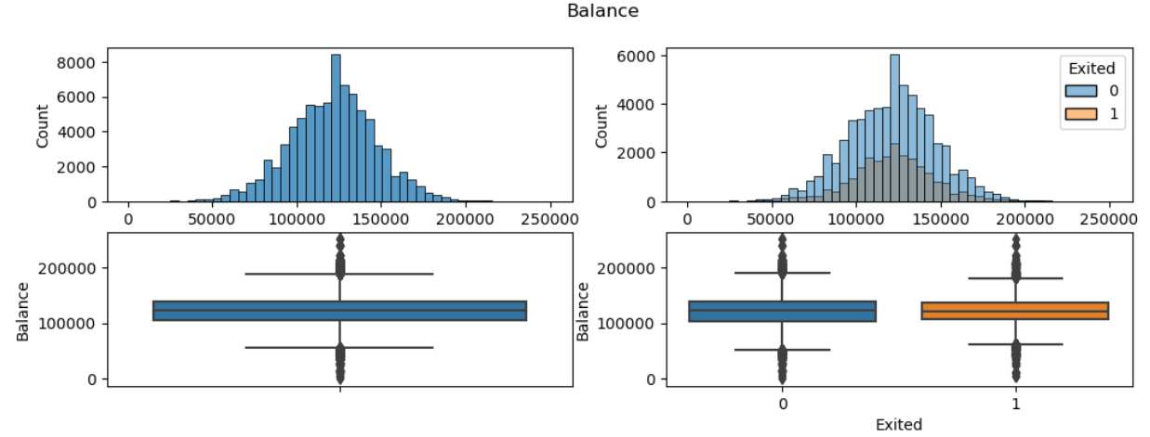
Numerical Features - Histplot and Boxplot
In Feature – Balance, there are lot of customers who were having bank balance – 0 so avoided visualization from this and getting bigger picture of balance column. Also there are much outliers present in this
Notes:
Very weak correlations in general. Only weak positive correlation with age, very weak positive correlation with balance, and very weak negative correlations with number of products and membership.
The density plots on the diagonal make it easier to compare these distributions. We can notice that only few features have slightly different distributions. For example, from the density plot for Age, it could be seen that older people have slightly higher tendency to leave the bank.

Slide 31
Selecting Model for Predicting Churn in dataset

Slide 32
Methods / techniques used to build a model
Classification techniques
Logistic Regression Model
Tree Model – Random Forest Model
Boosting Method – Xtreme Gradient Boosting Model

Slide 33
Methods / techniques used to build a model
Logistic Regression Model
Used for binary classification problems (predicting two outcomes)
Advantages:
Simple and easy to understand
Fast training and prediction times for smaller datasets
Disadvantages:
Assumes a linear relationship between features
Limited flexibility for capturing complex patterns in data

Slide 34
Methods / techniques used to build a model
Random Forest Model
Versatile for both classification and regression tasks
Advantages:
Handles non-linear relationships well
Robust to overfitting, as it combines multiple decision trees
Can handle large datasets with many features
Disadvantages:
Less interpretable compared to a single decision tree

Slide 35
Methods / techniques used to build a model
Extreme Gradient Boosting
Extremely powerful for classification and regression tasks.
Advantages:
High predictive accuracy due to the boosting technique
Handles complex relationships and interactions in the data
Regularization techniques to prevent overfitting
Can handle missing data effectively
Disadvantages:
Can be computationally intensive and require more resources.

Slide 36
Methods/techniques used to build a model – what to use for this dataset
Conclusion:
XGBoost is considered the best choice among these models for several reasons:
It combines the strengths of both random forests and gradient boosting.
It usually outperforms other models in terms of predictive accuracy.
It handles complex relationships and large datasets well.
Regularization techniques help prevent overfitting.

Slide 37
Model Training Steps
Model selection and training on train data
Hyperparameters tuning:
parameters grid with Optuna
GridSearchCV
StratifiedKfold
Check ROC-AUC score
Re-train model for best ROC-AUC score
Save best model
Feature Importance
Predict Exited value in Test data

Slide 38
Conclusions
Huge difference with StratifiedKfold split
Optuna resulted speed and better hyperparameter tuning
Ways for improvement
More data points for target variable imbalance situation
Feature engineering
Additional ML algorithms and imbalance handling techniques

Slide 39
Questions?
For detailed understanding now will move to Python Notebook

